Slide 1
Revision Clocks

Slide 2
What you need to do…
Write the headings into each section of your clock
Think about how you will break your ONE topic up into 8 sections.
This will involve combining some of the sections in a way that makes sense e.g.
‘What is biodiversity and why is it important?’ could be merged with ‘How can biodiversity be maintained?’

Slide 3
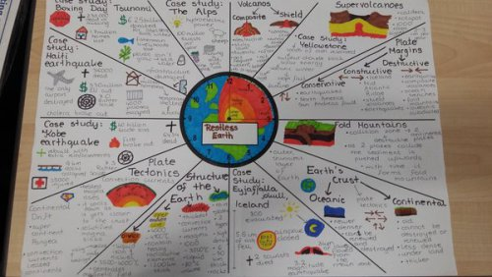

Slide 4
Section 1
Pictures, words, sentences, bullet points…

Slide 5
Section 2
Pictures, words, sentences, bullet points…

Slide 6
Section 3
Pictures, words, sentences, bullet points…

Slide 7
Section 4
Pictures, words, sentences, bullet points…

Slide 8
Section 5
Pictures, words, sentences, bullet points…

Slide 9
Section 6
Pictures, words, sentences, bullet points…

Slide 10
Section 7
Pictures, words, sentences, bullet points…

Slide 11
Section 8
Pictures, words, sentences, bullet points…

Slide 12
Section 9
Pictures, words, sentences, bullet points…

Slide 13
Section 10
Pictures, words, sentences, bullet points…

Slide 14
Section 11
Pictures, words, sentences, bullet points…

Slide 15
Section 12
Pictures, words, sentences, bullet points…

