Slide 1
Revision Clocks

Slide 2
What you need to do…
Write the headings into each section of your clock
Think about how you will break your ONE topic up into 8 sections.
This will involve combining some of the sections in a way that makes sense e.g.
‘What is biodiversity and why is it important?’ could be merged with ‘How can biodiversity be maintained?’

Slide 3
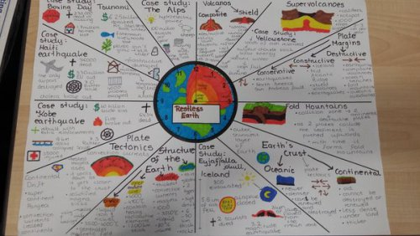

Slide 4

1- 5 Minutes
5 minutes
ANYTHING GOES!
Pictures, words, sentences, bullet points…

Slide 5
6-10 Minutes
5 minutes
MAXIMUM 10 WORDS
Try pictures, symbols and colour.

Slide 6
11-15 Minutes
5 minutes
MAXIMUM 5 WORDS
Think more creatively about your use of pictures, symbols and colour.

Slide 7
16-20 Minutes
5 minutes
NO WORDS
Try pictures, symbols and colour.

Slide 8
21-25 Minutes
5 minutes
ANYTHING GOES!
Try pictures, symbols, colour, pictures, words, sentences, bullet points…

Slide 9
26-30 Minutes
5 minutes
ANYTHING GOES!
Try pictures, symbols, colour, pictures, words, sentences, bullet points…

