Slide 1

Y11 2021 Mock Exams
What to expect, rules and regulations

Slide 2
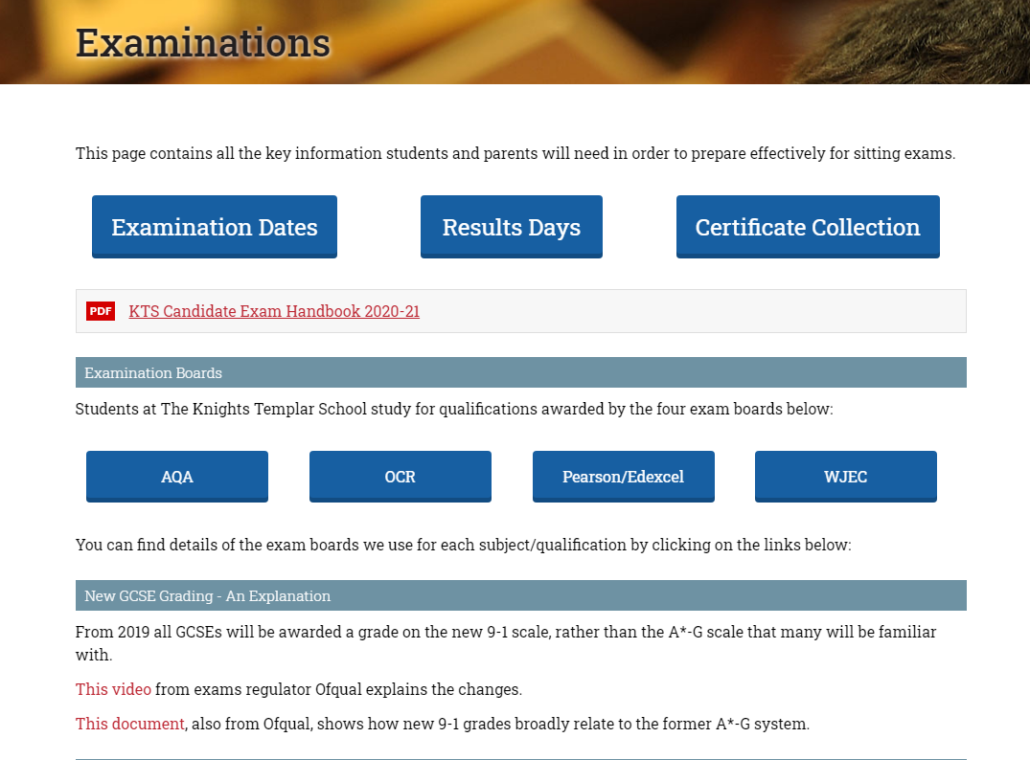
Candidate Exam Handbook
It is available on the school website;
Parents and Carers
Examinations
It can also be found on the home page of any school computer

Slide 3
Candidate Exam Handbook
This handbook gives you all the information you need to sit exams at KTS
MAKE SURE YOU READ IT AND ASK YOUR PARENTS/CARERS TO READ IT TOO.

Slide 4

Timetable
This is also available on the school website;
Students
Examinations
And on the noticeboard outside the exams office and K3

Slide 5
Year 11 Mock Exams
We will run these exams exactly as we will for your GCSEs so you get the practise of how you are expected to behave. We’re going to look at the rules that we have to follow and how they differ from Y7-Y9 exams …

Slide 6
INVIGILATORS
The main difference between your exams in Y9 and Y10 is the introduction of external invigilators
RESPECT
LISTEN

Slide 7
Year 11 Exams
Invigilators, no teachers
Ensure you are comfortable
Make sure you have the correct paper in front of you
Check you aren’t cheating

Slide 8
Arrival
You are expected to arrive 15 Minutes before your exam:
Morning exams start at 8.45am
Mid Morning exams start at 11.15am
Afternoon exams start at 1.45pm
You should wait QUIETLY in the area outside your exam room

Slide 9
Where to Wait
For exams in the hall – line up in the courtyard outside the dining room in your rows.
For exams in the old gym – line up outside the gym in your rows.
If you have a reader or a scribe and are sitting your exam in a classroom wait quietly outside that room.

Slide 10
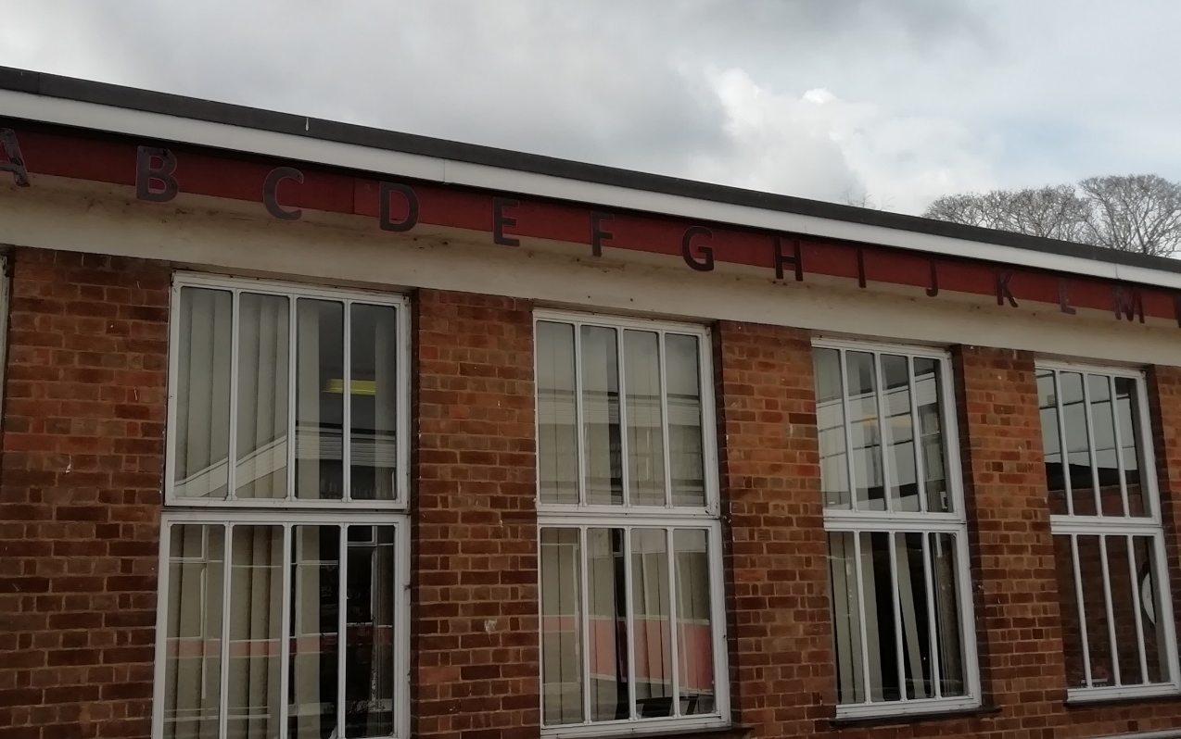
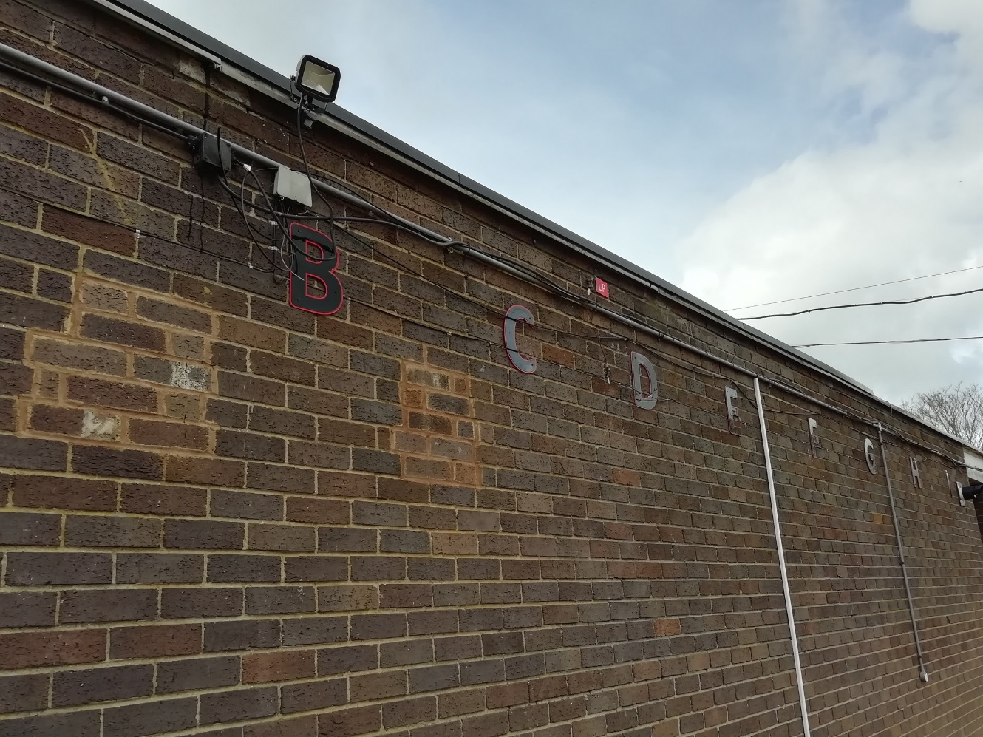
Year 11 Exams
Line up

Slide 11
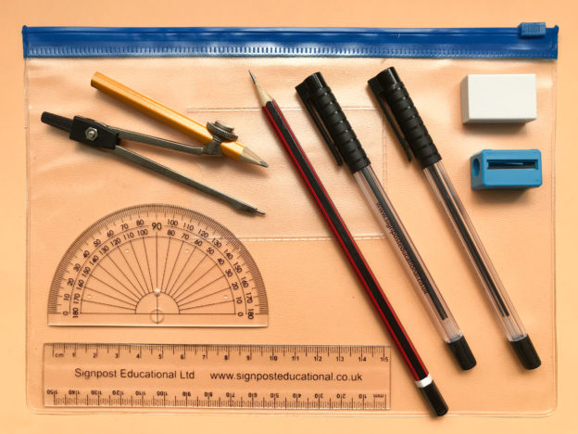
Entering The Exam Room
You will be called in row by row.
Ensure you show your pencil case to the invigilator as you enter the exam room – before EVERY EXAM.

Slide 12
Equipment
IT IS YOUR RESPONSIBILITY TO BRING THE EQUIPMENT YOU NEED
FOR EVERY EXAM YOU WILL NEED
Black pens (at least 2)
HB pencils (at least 2)
Eraser
Ruler
Pencil Sharpener
If using a pencil case it must be a clear one.

Slide 13
Equipment
IT IS YOUR RESPONSIBILITY TO BRING THE EQUIPMENT YOU NEED
FOR CERTAIN EXAMS YOU WILL NEED
Calculator – without lid or formulae information
Compass
Protractor
Coloured Pencils
If using a pencil case it must be a clear one.

Slide 14
Equipment
What else can you bring in to the exam room?

Slide 15
Equipment
What else can you bring in to the exam room?
Water – in a clear bottle NO LABEL

Slide 16
Banned equipment
No mobile phones, i-watches, i-pods, MP3/4 or any electronic item that has digital storage.
Do not bring in notes, study guides or any blank paper.
Don’t bring in your timetable – please leave it in your bag.
Leave bags in the dining room or gym changing room. DON’T bring them with you to an exam

Slide 17
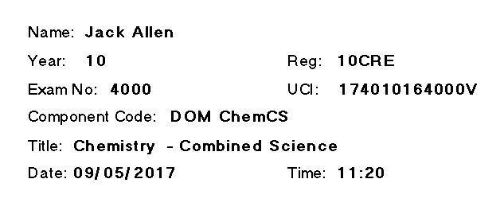
Exam Desk Labels
You will find your ID label on the desk, you will need to enter the room and find your seat in silence.
You will not always be in the same seat, so make sure you are sitting in the correct place.

Slide 18
Entering The Exam Room
As soon as you enter the exam room you are under exam conditions.

Slide 19
Entering The Exam Room
As soon as you enter the exam room you are under exam conditions.
Silence

Slide 20
Entering The Exam Room
As soon as you enter the exam room you are under exam conditions.
Silence
No communicating with anyone else in any way

Slide 21
Entering The Exam Room
As soon as you enter the exam room you are under exam conditions.
Silence
No communicating with anyone else in any way
Sitting down waiting for instructions from the invigilators

Slide 22
Entering The Exam Room
As soon as you enter the exam room you are under exam conditions.
Silence
No communicating with anyone else in any way
Sitting down waiting for instructions from the invigilators
Do not touch the exam papers until told to do so

Slide 23
Exam room
As previously mentioned you must enter the room in silence and stay silent until you leave the room at the end of the exam.

Slide 24
Starting An Exam
You may be asked to write your name and candidate number. This is sometimes called your exam number.

Slide 25
Centre Number
17401

Slide 26
JCQ Rules
The exam boards are overseen by JCQ (the Joint Council for Qualifications).
JCQ make the rules by which the exam boards AND the centres have to abide.
THESE ARE JCQ RULES NOT KTS

Slide 27
During The Exam
No talking or communicating in any way with any other candidate.
If you need anything during the exam you put your hand up and wait for the invigilator to come to you (do not say anything/call out).
When you have finished your exam paper, thoroughly check it and check it again. You remain silent, DO NOT ASK IF YOU CAN LEAVE.
You remain under exam conditions until you leave the exam room.
Do not tap on the table, click pens or anything that could put others off.
Do not doodle on your scripts, you may lose marks.
You are not the only one in the room be considerate to others!

Slide 28
During The Exam
Exam conditions are there to make things equal for everyone. If you break the rules they will be noted down on an incident form and we are obliged to advise your teachers and Mrs Lardeaux of this. We will also advise your parents/carers that you have chosen to break the rules and the possible consequences of your actions.
In your GCSE exams we would be obliged to tell the Exam boards and
EXAM BOARDS TALK!!
If one Exam board decides that you should be disqualified from that Exam, depending on the severity of the rule break, you may be disqualified from all of your exams.

Slide 29
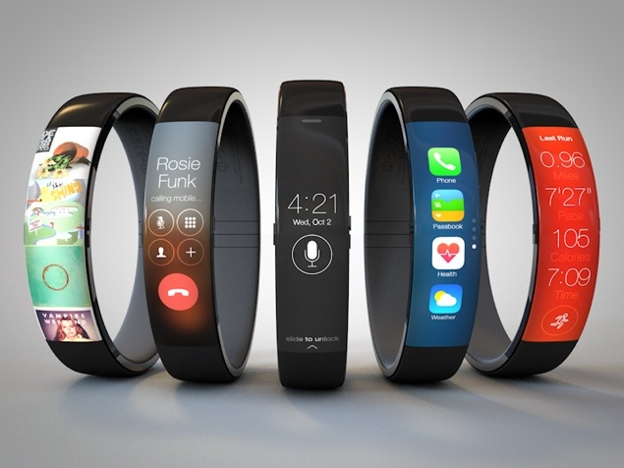
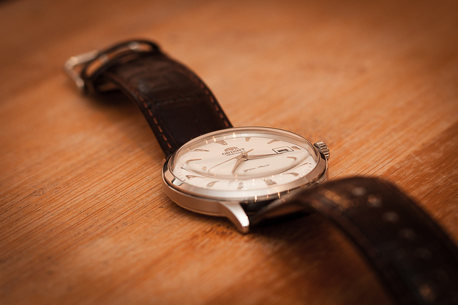
Watches
Watches MUST be placed on the desk in full view of the invigilators. Failure to do so is MALPRACTICE.

Slide 30
Toilet breaks
Due to the length of your exams, you shouldn’t need to go during them. If you desperately need to go, put your hand up and the invigilator will come to you and then arrange for an accompanied toilet break (no extra time will be allowed). Invigilators MUST note this down. If it is noticed that you ask to go in every exam it may be investigated.
GO BEFORE YOUR EXAM YOU HAVE TIME!

Slide 31
End of the Exam
YOU WILL BE GIVEN A 5 MINUTE WARNING THAT THE EXAM IS ABOUT TO FINISH.
You must stop writing when asked, even if you are part way through something.
YOU MUST REMAIN SEATED AND IN SILENCE.
You will be dismissed row by row. REMAIN SILENT. There may be more than one exam going on in the room that has a later finish time.
STAY SILENT until you are away from the exam room.

Slide 32
Anything Else
If you have any concerns during the exam, you must advise the invigilator at the time or at the end of the exam and not later. All concerns will be noted.

Slide 33
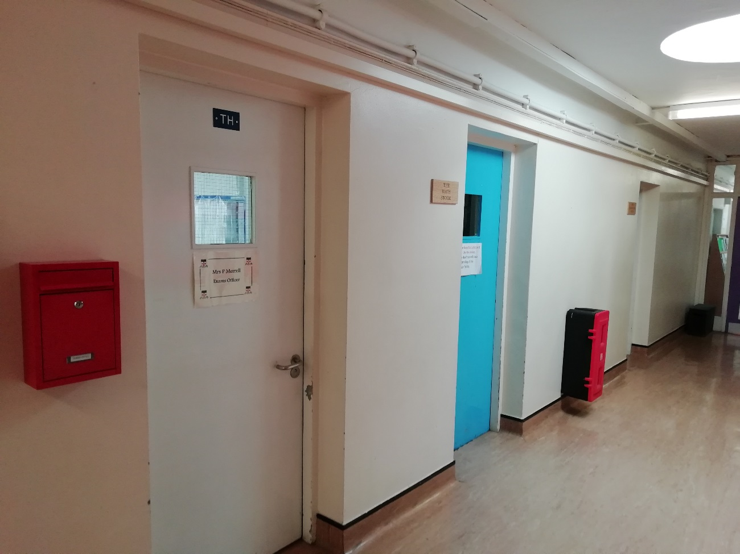
See Me
If you have any questions, concerns or worries about the exams you are welcome to see me in my office.

Slide 34


